Slide 1
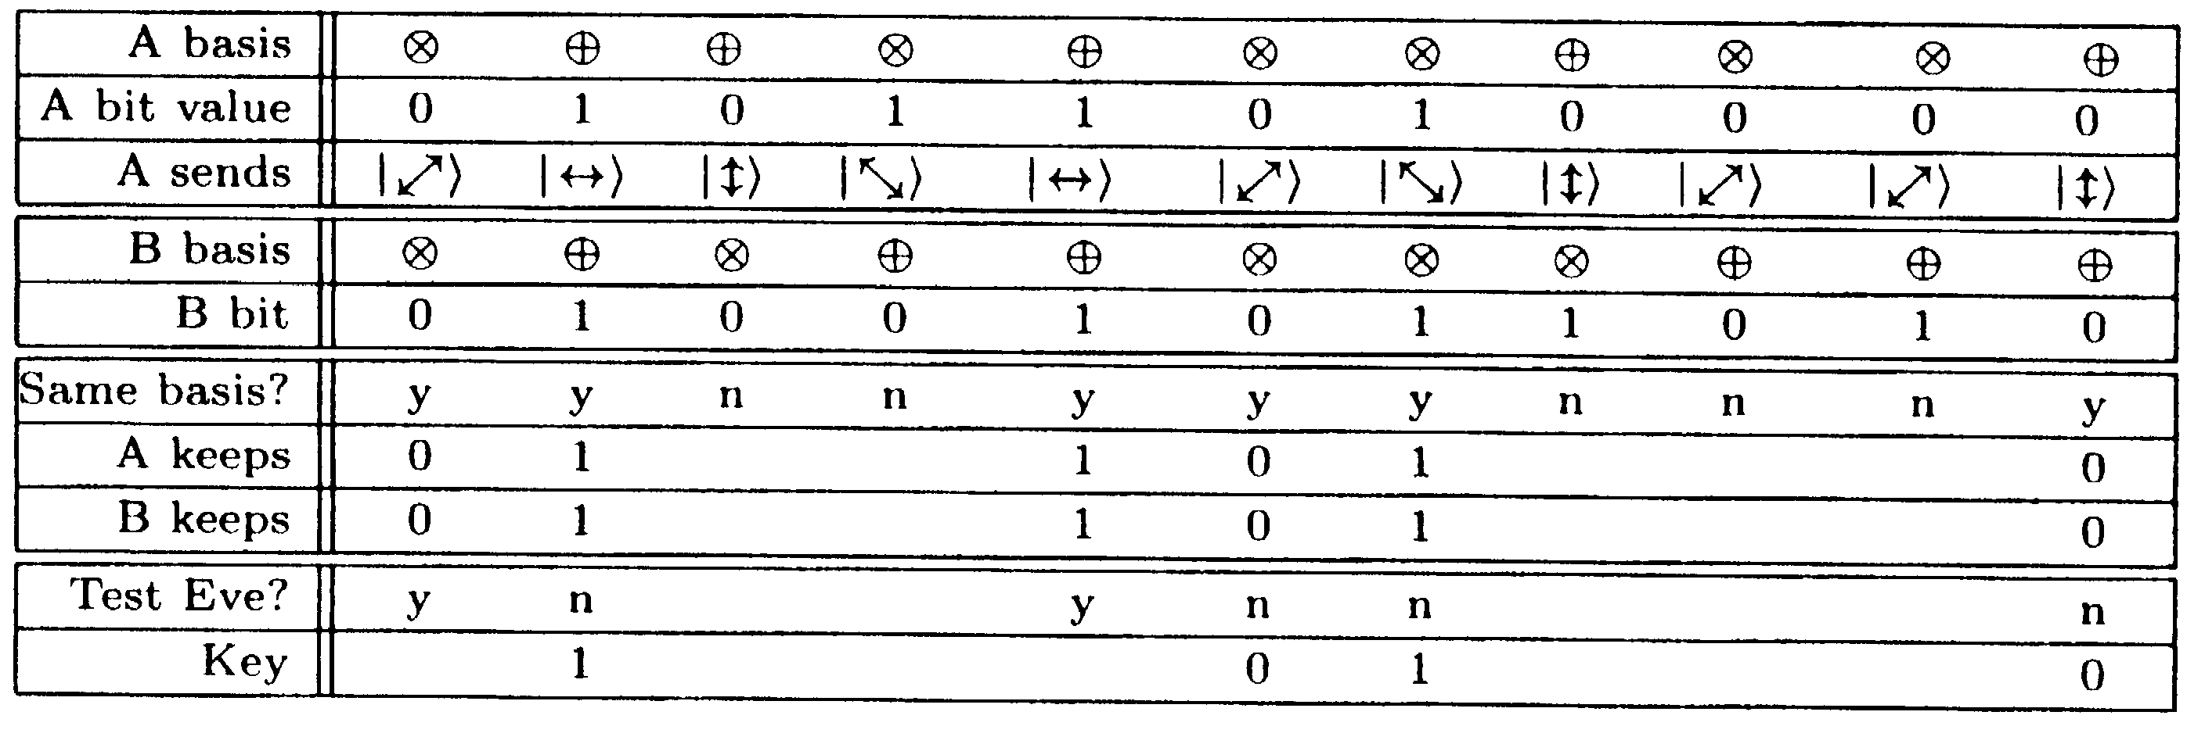
aus: “The Physics of Quantum Information”,
Bouwmeester, Eckert, Zeilinger (Eds.), Springer (2000)

